Slide 1

Bi project of Customer Churn Analysis
agenda
Business problem
Analysis/ results
Methodology
Discussion & proposed solution
Joseph Hasheley scheitzer

Slide 2
problem
the problems facing the company are
1 the unsubscribe rate is increasing more and more .
2 the services offered by the company do not relate to all customers
3 the considerable loss

Slide 3
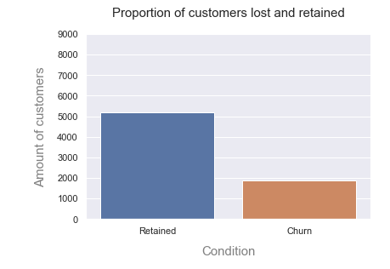
Results
73,46%
26,53%
the percentage of unsubscribers is equivalent to 26.53% or 1869 of the total number of customers which is 7043 subscribers

Slide 4
Results
the types of customers who churn are
the types of clients who unsubscribe are those who do not have a partner, since we find that 1,200 out of 1,869 clients who do not have a partner unsubscribed this month.
women with a rate of 50.24%.
We also note that customers who are not dependent on any person unsubscribe much more, a rate of 1543 out of 1869 or 82.87% of unsubscribers.
customers with telephone service: 90.90%
Those who use fiber optics as an internet service unsubscribe more than the others, a rate of 69.39%

Slide 5
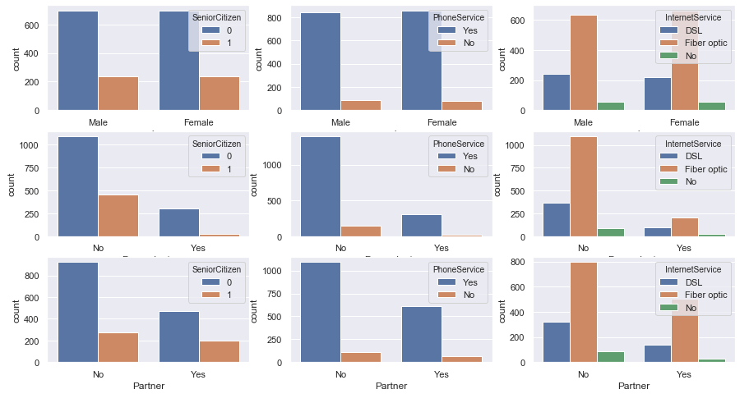
Results

Slide 6
Discussion & proposed solution
in the space of a month the telecommunication company made a fairly considerable loss, a loss of 139,130.85 on 456,116.6 which equates to a rate of 30.50%so to reduce this infernal rate of unsubscribers it is essential to increase the quality of some services compared to quick few customers

Slide 7
References & appendices

